Slide 1

INTERMITTENT FASTING AN EFFECTIVE THERAPY IN PREVENTING METABOLIC DISEASES IN MICE ….. AND HUMANS?
Sybrand E. Smit
MRC Journal Club
9 March 2015
Notes:
Good Day, everyone and thank you for this opportunity to be presenting... what I consider to be rather fascinating research in the fight against obesity and diabetes. The topic of my discussion is “Intermittent Fasting: an effective therapy in preventing metabolic diseases in mice... and maybe humans as well?”. Exciting times :)
http://www.alexandersmkt.com/wp-content/uploads/2014/02/fasting.jpg

Slide 2
Intermittent Fasting
Caloric Restriction
20 – 50% reduction in energy intake.
Intermittent Fasting
Fasting Period
Restrict energy intake for 18 hours of the day
Feed Day (Ad libitum food consumption)
Eat freely for rest of the day
Alternate Day Fasting
Notes:
So, first of all, what is intermittent fasting? Well, as the term implies, it is fasting (or going without food) for certain periods at a time. Thus, it is not a diet, but a dietary pattern.
Now, we are all aware that the whole issue around metabolic diseases, such as diabetes and being obese in general, are due to having an excess energy intake compared to what we are actually utilizing on a daily basis. Thus, if the carbohydrates and fats we consume is not expended it will be stored as extra weight. The first line of treatment has therefore been argued to be a dietary intervention. Such as caloric restriction. Progressively we try and reduce our daily energy intake by cutting our portions during meals. The problem for most with this approach is the constant feeling of not being satisfied after finishing these meals. You’re left longing for more. Therefore new approaches have been formulated. One of which is intermittent fasting. It consists of reducing your feeding window for the day to 6 hours and then fasting for the rest of the day. I will discuss practicalities later in the talk. There are also variations on this approach, such as fasting complete days, followed by an ad libitum day (a day of anything goes). And then repeating this cycle.

Slide 3
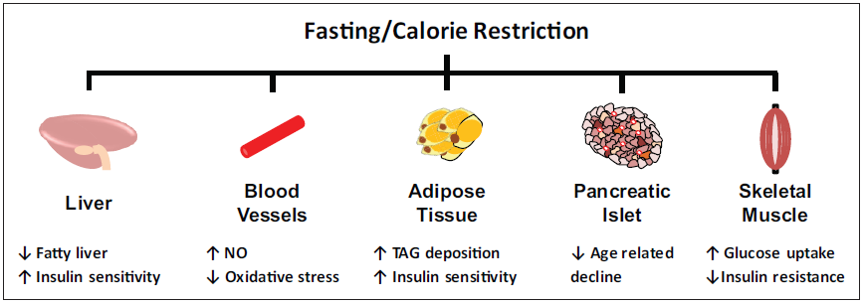
Diabetic Indicators?
Intermittent Fasting vs Caloric Restriciton
IN OVERWEIGHT AND OBESE INDIVIDUALS
Notes:
In humans, intermittent fasting as well as caloric restriction has shown to have great potential for reducing diabetic risk factors in overweight and obese individuals. These include reducing body weight, lowering fasting blood glucose, decreasing insulin resistance within muscle cells and also improving insulin sensitivity in the liver, which improves glucose homeostasis.

Slide 4
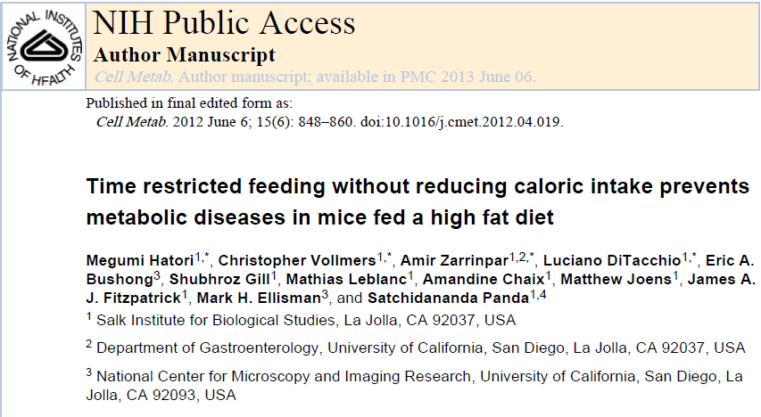
Notes:
Okay, so, to give some evidence to my “claims”. I will present a study done by Hatori and colleagues, titled “Time restricted feeding without reducing caloric intake prevents metabolic diseases in mice fed a high fat diet”.

Slide 5
Circadian Rhythms
Energy metabolism in animals evolved to be cyclical
nutrient availability
Circadian Rhythm
Controls the feeding-fasting cycle which drives metabolism
Notes:
Given that food is not readily avaible to animals, their metabolism has evolved to be subjected to a daily cycle that regulates their feeding-fasting cycle, or energy intake and energy expenditure. This cycle is known as the Circadian Rhythm. (and it’s a guaranteed scrabble winner if you manage to get a triple word score with the word rhythms.Hehe)
http://ehp.niehs.nih.gov/wp-content/uploads/118/1/ehp.118-a28.g002.png

Slide 6
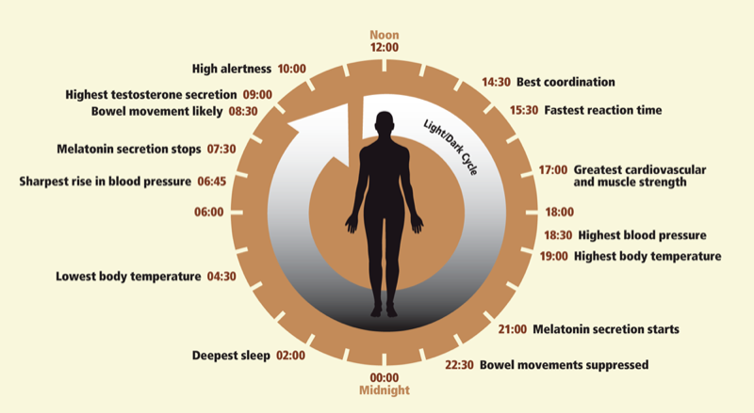
Circadian Rhythms
Energy metabolism in animals evolved to be cyclical
nutrient availability
Circadian Rhythm
Controls the feeding-fasting cycle which drives metabolism
Notes:
In humans for instance, our daily rhythms has various physiological consequences, such that there are optimum times to be doing certain tasks. As you can see here, this part of the day is where movement can be our greatest attribute, followed by resting, slowly drifting into sleeping territory. And then our morning hours is optimum for brainstorming given our alertness. The way we function is ofcourse a function of our metabolic state. Whether we are consuming or spending energy.
http://ehp.niehs.nih.gov/wp-content/uploads/118/1/ehp.118-a28.g002.png

Slide 7
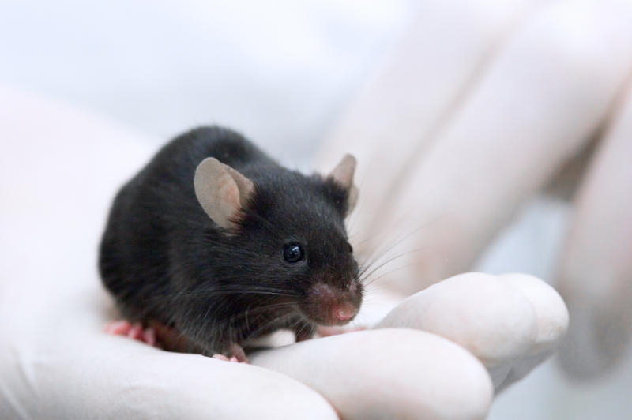
Experimental Design
8 Weeks old male C57BL/6J mice housed (3–5 mice/cage) under a 12h light:12h dark schedule for 4 weeks to adapt
Notes:
So lets look at the experimental design of this study. They took 8 week old male C57BL/6J mice and housed them under a 12hour light, 12 hour dark cycle for 4 weeks to adapt.
http://images.sciencedaily.com/2013/03/130314180303-large.jpg

Slide 8
Feeding Schedule and Diets
NA | Normal Chow Ad Libitum Feeding
NT | Normal Chow Time Restricted Feeding
FA | High Fat Ad Libitum Feeding
FT | High Fat Time Restricted Feeding
Group | Utilized for Energy |  |  | Food Availability
 | Carbohydrate (%) | Fat (%) | Protein (%)
NA | 58 | 13 | 29 | 24 Hours
NT | 58 | 13 | 29 | 8 Hours
FA | 21 | 61 | 18 | 24 Hours
FT | 21 | 61 | 18 | 8 Hours
Mice nocturnal creatures – For fasting groups, food made available 1hour after lights off and 3 hours prior to lights on
Diet | Total Saturated Fatty Acids (%) | Total Mono-unsaturated Fatty Acids (%) | Omega-6 (%) | Omega-3 (%) | Total Fat (%)
NA | 1.6 | 1.6 | 1.3 | 0.2 | 5.0
FA | 13.7 | 14 | 5.1 | 0.4 | 34.9
Notes:
Then they divided them into 4 treatment groups. A normal chow group which was aloud to eat at will and one group who was only allowed to eat for 8 continuous hours per day. And a high fat diet group which was allowed to eat as much as they wanted, and a last high fat diet group who is only allowed to eat for 8 hours per day.
As you can see from a breakdown of these diets, there is a significant increase in fat consumption in the high fat diet and these are mainly the fats known to facillitate in weight gain – your saturated fatty acids and mono-unsaturated fatty acids.

Slide 9
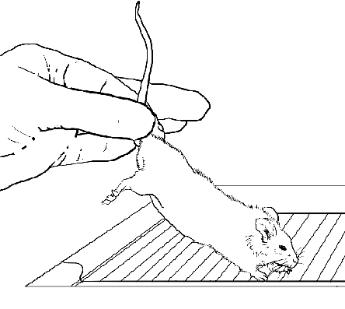

Handling and Food Measurement
Mice transferred between cages daily to control food access.
Weekly food intake was measured by monitoring the weight of the remaining food.
Notes:
The mice were transferred daily to control the access to food and the food intake was measured by monitoring the weight of the remaining food.
http://www.brl.uic.edu/media/images/species/mice/lfig3.gif
http://www.brl.uic.edu/media/images/species/mice/lfig1.gif

Slide 10
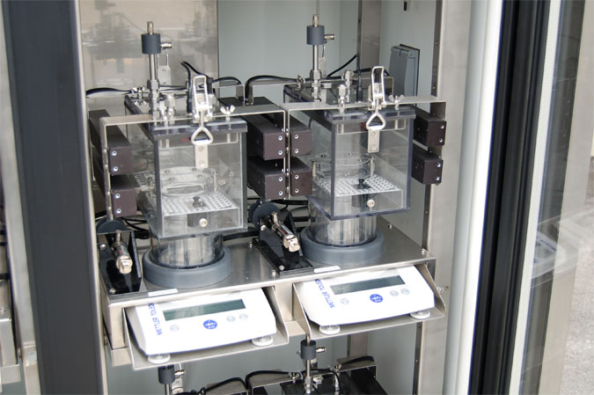
Metabolic Cages
Whole body metabolic states were tested by indirect calorimetry in a CLAMS system (Columbus Instruments) for 2 days after 4 days of habituation.
Notes:
They made use of some very fancy equipment. One of which is the Metabolic cages that measure calorimetry by detecting O₂ consumption and CO₂ exchange, together with body weight and thereby calculating the amount calories spend.
http://www.kuoyang.com.tw/LS/Download/PorductImage/CornerCLAMS.jpg

Slide 11

Glucose Tolerance
Mice were fasted for 16 h and fasted glucose was measured using a Glucometer (One Touch Ultra™) by tail-bleeds.
Subsequently, mice were intraperitoneally injected with 1 g glucose/kg of body weight, and blood glucose was measured in intervals of 30 min for 2 h.
Notes:
Fasting blood glucose and glucose tolerance was also determined.
http://www.mte.cz/images/glukometr-one-touch-ultra.jpg

Slide 12
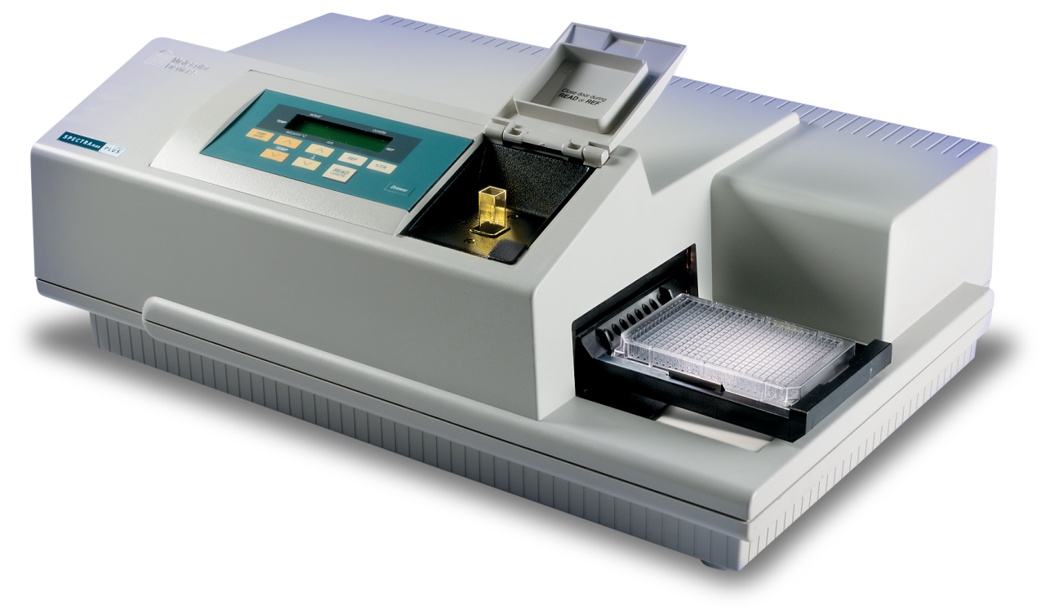
Insulin and Leptin ELISA’s
In a second group, overnight fasted mice were intraperitoneally injected with 1 g of glucose/kg of bodyweight and retro-orbital blood was collected after 1 h.
Insulin and Leptin ELISAs were measured in the blood of fasted and glucose-injected mice.
Notes:
Insulin and leptin levels were measured in fasting mice and detected using an enzyme-linked immunosorbent assay.
http://www.moleculardevices.com/sites/default/files/products/SpectraMaxPlus384%20TPBG.pnghttp://www.moleculardevices.com/sites/default/files/products/SpectraMaxPlus384%20TPBG.png

Slide 13
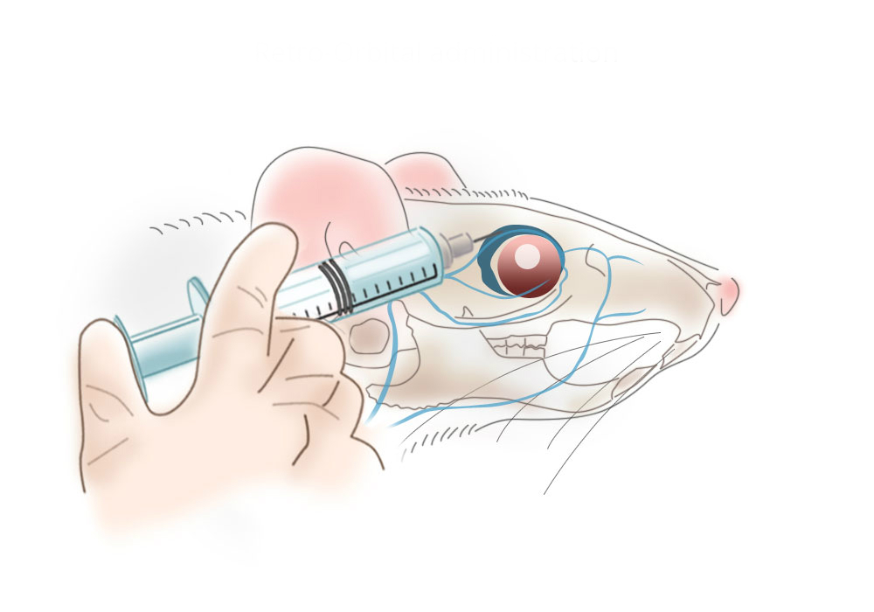
ALT and Cholesterol
Mice were fasted for 16 h starting from ZT21 (3 hours prior to lights on), and blood was collected retro-orbitally.
Alanine aminotransferase (ALT) and Cholesterol were assayed
Notes:
Blood was also obtained retro-orbitally to assay alanine aminotransferase and cholesterol levels.
http://www.clodrosome.com/wp-content/uploads/2014/02/Retro-Orbital-administration_blank.jpg

Slide 14
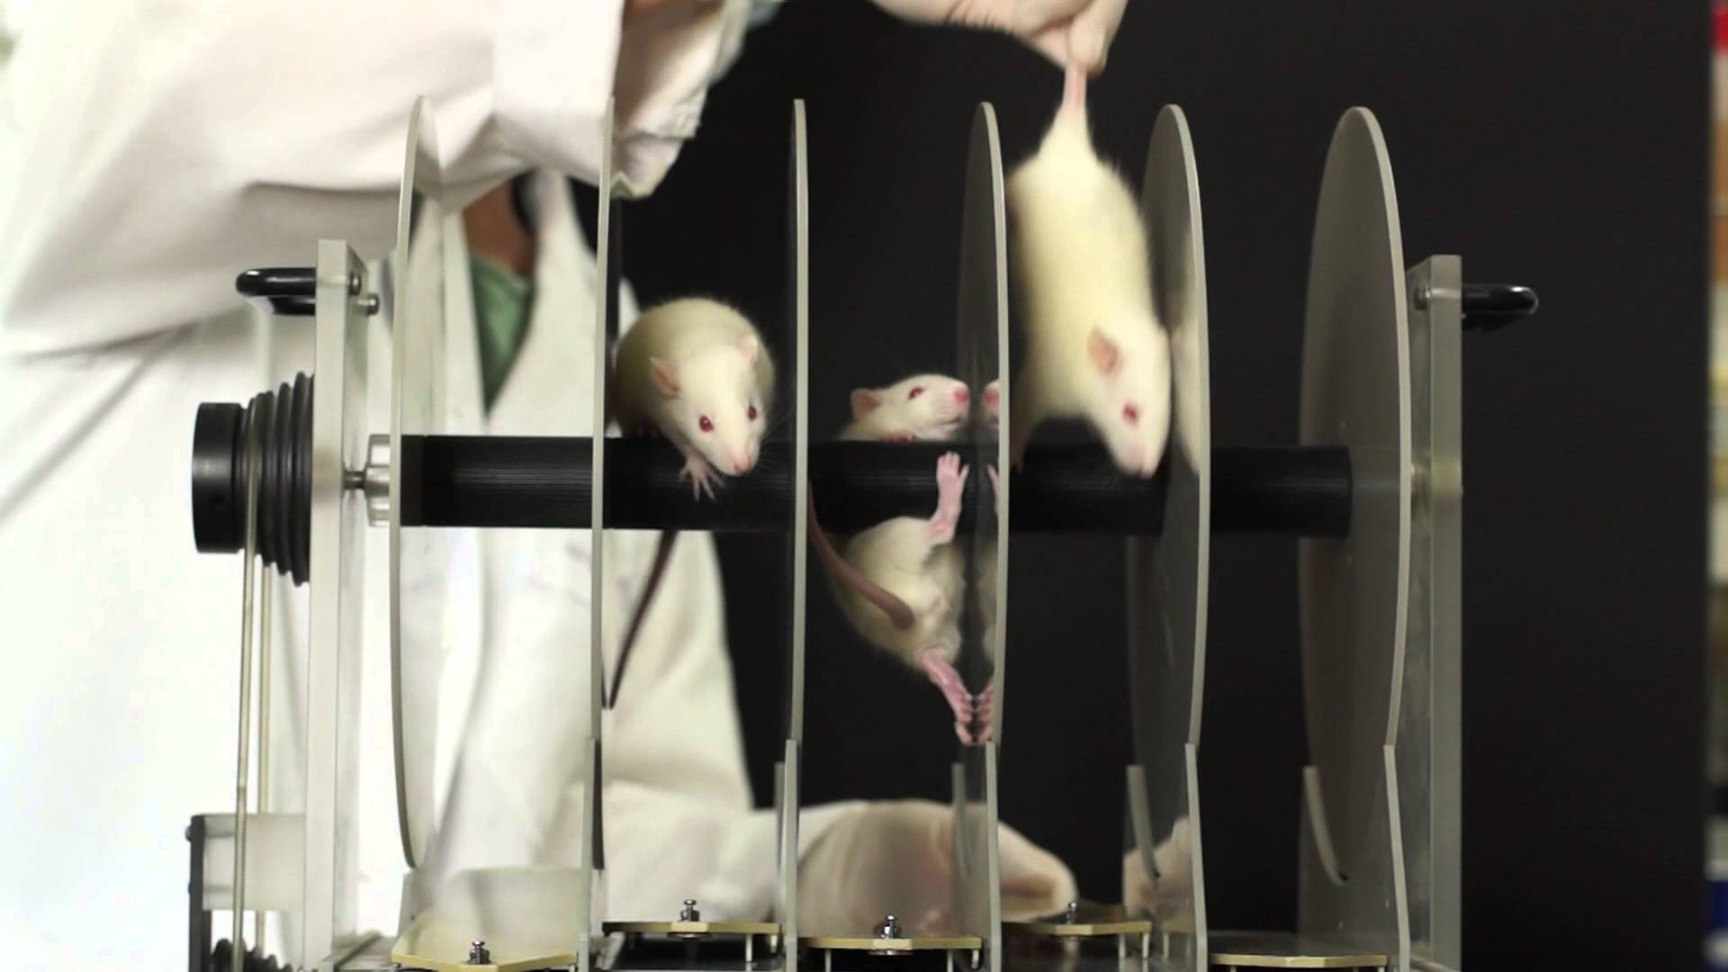
Rotarod
Mice were placed on accelerating (10 – 70 rpm) rotarods for up to 180 sec.
Mice were tested on subsequent days
On the first day, mice were given 5 trial runs for habituation.
Data was collected from 3 runs on the second day after 2 trials runs.
Notes:
To test the motor functions, they made use of rotarods, which spins at speeds of 10-70 rpms, and is designed to test the mice’s responsiveness and grip strength to steady themself on the rotating platform. The mice were allowed trial runs, after which the data from 3 runs were used.
http://i.ytimg.com/vi/v56MtrmWAs0/maxresdefault.jpg

Slide 15
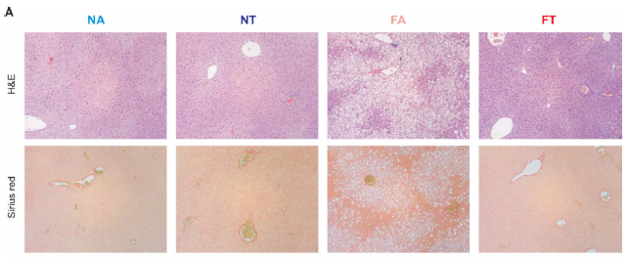
Histology
Sections (6 um) of formaldehyde fixed liver, white adipose tissue and brown adipose tissue were stained following standard H&E (hemotoxylin and eosin).
Liver sections were also stained using Sirius Red method.
Representative histopathology (upper panel, H&E, Scale bars 200um) and
Sirius red (lower panel, Scale bars 200um) of the liver.
Notes:
Sections of tissue from the liver, white adipose tissue and brown adipose tissue was fixed and stained with H&E and also using the Sirius Red method.

Slide 16
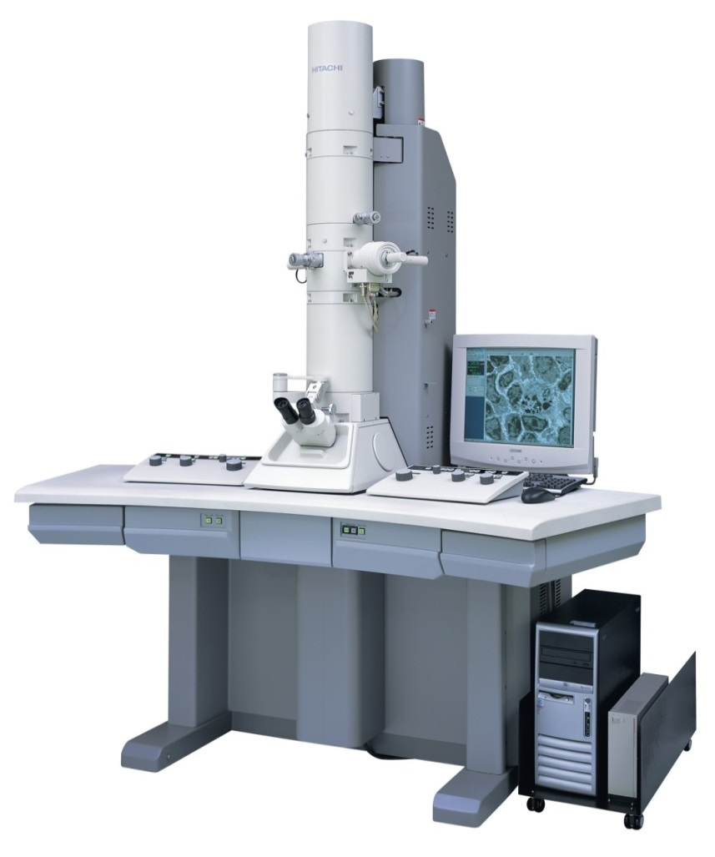
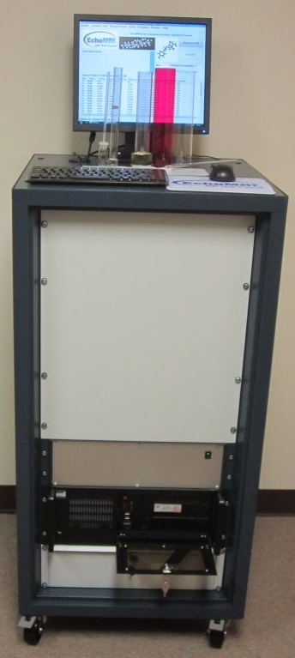
Cellular and Body Composition
Cellular composition determined with a Scanning Electron Microscope
Body fat and lean mass of live mice was assessed using a mouse MRI (Echo Medical Systems).
Notes:
The liver samples were also analyzed with a scanning electron microscope to determine the cellular composition. The body fat index and lean mass of live mice was assessed using a mouse MRI.
http://www.echomri.com/Body_Composition_3_in_1.aspx

Slide 17
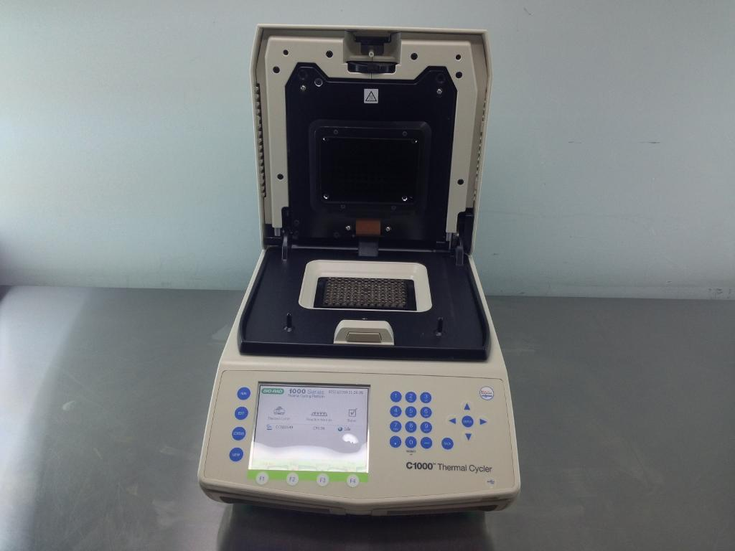
Transcript Protein and Metabolite Analyses
Mice were sacrificed every 3 h over 24 h period, and individual liver, WAT and BAT were flash frozen.
Immunoblotting and quantitative RT-PCR analyses
Notes:
The transcript proteins is the one aspect I will not be discussing in full today, simply because of time constraints. They did however do a quantitative real time PCR analyses on the liver and fat samples, and also performed immunoblotting.
http://www.thelabworldgroup.com/pcr-thermal-cyclers-biorad-cfx96-qpcr-used-rt-pcr-system-200185

Slide 18

Notes:
Okay, so onto the results
http://delmosports.com/wp-content/uploads/2013/10/results.jpg

Slide 19
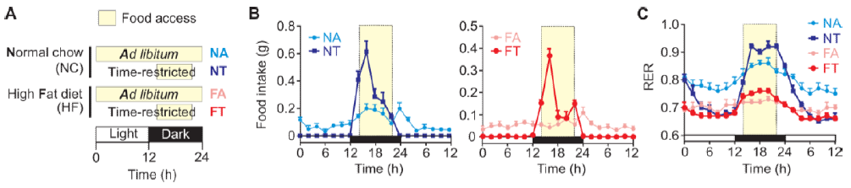
Time of Feeding Shapes Metabolism
(A) Four feeding regimens used. tRF mice allowed food access from ZT13 through ZT21
(B) Food Ingested
(C) Respiratory exchange ratio (CO₂ exhaled/O₂ inhaled)
NC Ad lib - diurnal rhythms in their food intake and whole body RER
HF Ad lib – dampened diurnal rhythms
NC tRF – improved diurnal rhythms
HF tRF – improved diurnal rhythms
Notes:
To recap, they had 4 different feeding regimes. Given that mice are nocturnal creatures, the fasted groups were allowed to eat from 1 hour after lights off up until 3 hours before lights on. As you can see the normal chow ad libitum group displayed a diurnal rhythms in their food intake and whole body respiratory exchange ratio. Food intake and RER exhibited a nocturnal increase, reflective of feeding and subsequent carbohydrate utilization, and declined during the day, consistent with lipid oxidation during fasting. Mice fed high fat diet under an ad lib regimen (FA) displayed dampened diurnal rhythms in food intake and RER. In contrast, mice fed normal chow or high fat diet under a tRF regimen (NT and FT) improved diurnal rhythms in their RER compared to their ad lib fed counterparts, with higher RER during feeding and reduced RER during fasting, indicative of increased glycolysis and fat oxidation respectively, which means there was

Slide 20
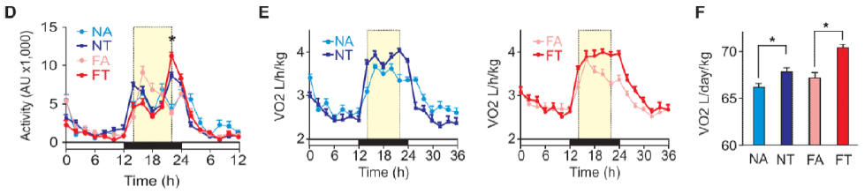
Activity
(D) Average Activity (+SEM, n= 4 mice)
(E) Whole body energy expenditure as measured by volume of O₂
consumed in 2h bins plotted against time.
HFD diet is energy rich (5.51 Kcal/g) and thus mice on
NC consumed equal amount of energy (3.36 Kcal/g)
(F) Food intake and energy expenditure expressed relative to individual animal or unit body weight.
All 4 groups nocturnally active
tRF regimen (FT and NT) showed increased activity
increased energy expenditure towards the end of the night
Notes:
All 4 groups were fairly active throughout the night, but it was noted that the fasting groups had a surge of activity towards the end of the night. This was measured in the metabolic cages by noting the amount of O­­­₂ consumed in 2 hour intervals.

Slide 21
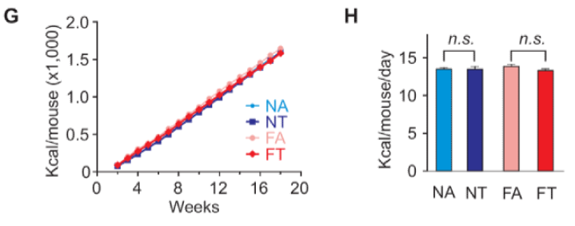
(G) Cumulative average energy intake
(H) Average daily energy intake (+SEM, n=24 over 17 weeks).
Average daily energy intake kept constant for all groups throughout 18 weeks of the experiment
Notes:
Just to show that the average daily energy intake remained constant through the 18 weeks study, and also that there was no significant difference between groups in the amount of energy consumed each day.

Slide 22
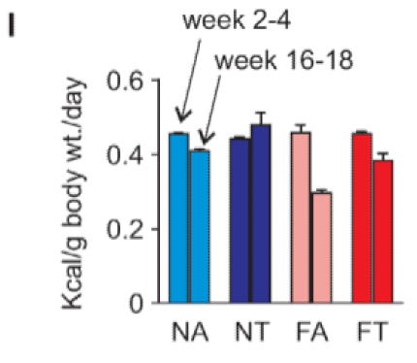
(I) Average energy intake (+SEM) normalized to unit body weight shows no difference at the beginning of the experiment. In subsequent weeks with gradual increase in body weight, this value progressively declines. By the end of 16-18 weeks, mice on tRF consume more energy/unit body weight than the ad libertum counterparts.
Time restricted groups consume more energy than ad libitum groups towards end of study
More active?
Notes:
The time restricted groups consumed more energy towards the end of the study than the ad libitum counterparts. This may be in due to an increased need for activity.

Slide 23
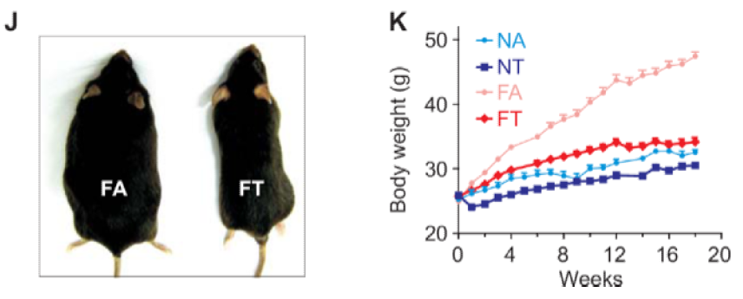
(J) Representative FT mice were remarkably leaner than the FA mice
(K) Average body weight (+SEM, n=20-32 mice)
Despite equivalent energy intake from the same nutrient source
FT mice protected against excessive body weight gain
FA mice not
Temporal feeding pattern reprograms the molecular mechanisms of energy metabolism and body weight regulation.
Notes:
Despite consuming the exact same amount of energy from the same nutrient source, fasting mice on the HFD were protected against the excessive weight gain observed in the high fat diet ad libitum group or snackers. This is evident that the temporal feeding pattern reprogram the molecular mechanisms of energy metabolism and body weight regulation.
This, is all you need to see to be convinced that intermittent fasting is an effective therapy in treating obesity.

Slide 24
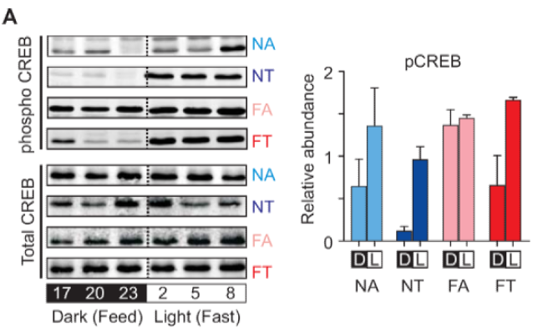
Notes:
In the liver, CREB phosphorylation plays a role in activating gluconeogenesis. In fasting groups this is consistent with a rise in the relative abundance of phosphorylated CREBs, indicating that the body is sustaining it’s energy needs through an elevated blood glucose level produced by liver enzymes. This was completely perturbed in the high fat ad libitum group.

Slide 25
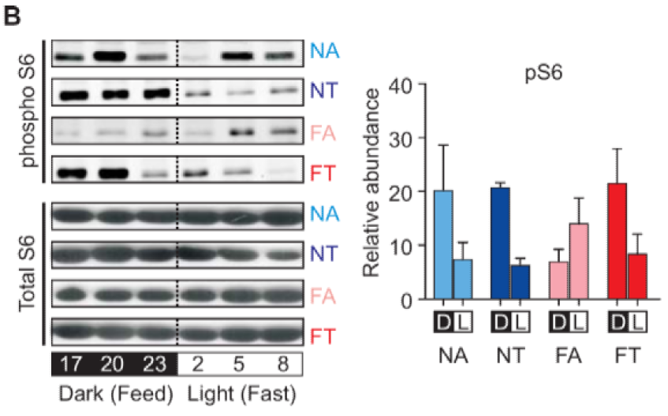
0
(B) phospho-S6 in the mouse liver
Notes:
Insulin during feeding times stimulate the mTOR-pathway and leads to the activation of pS6, which remains elevated during feeding in all groups except the high fat ad libitum diet group. The restricted feeding of high fat thus restored the balance in this regard.

Slide 26
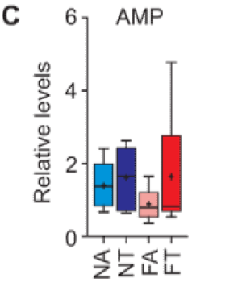
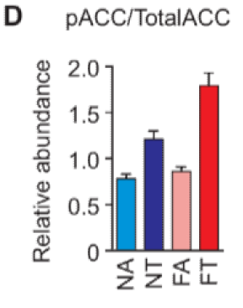
AMP and pACC
(C) AMP level in the liver of FT mice is signifcantly higher than that in FA mice.
(D) phospho-ACC relative to total ACC from mouse liver
Notes:
Upon activation by AMP, AMPK, an important switch protein in activating energy metabolism, phosphorylates and deactivates one of the rate limiting enzymes of fatty acid oxidation, acetyl CoA carboxylase (ACC) – SKIP

Slide 27
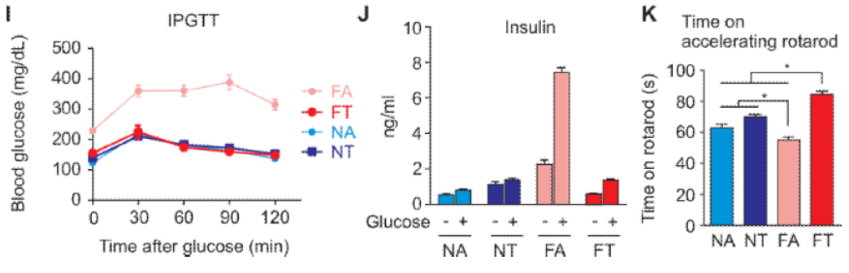
Insulin Levels and Rotarod Activity
IPGTT shows normal glucose tolerance in FT mice.
(J) Levels of blood insulin after overnight fasting or 1h after glucose infusion.
(K) Time spent on an accelerating rotarod
Notes:
FT mice did not display the hallmarks associated with glucose intolerance found in diet-induced obesity, instead showing glucose tolerance and insulin levels comparable to the control NA mice. The overall improvement in metabolic state also paralleled improved motor coordination in the mice under time restricted feeding regimes

Slide 28
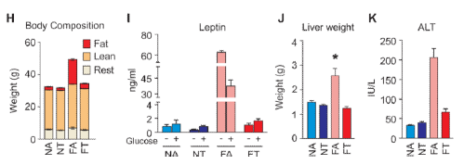
Body Composition, Leptin and Liver Weight
(H) Body composition analyses by MRI: tRF prevents excessive whole-body fat accumulation in HFD
Increased leptin levels indicates increased adipose tissue in FA mice.
(J) tRF also prevents enlarged liver and liver damage indicated by increased serum ALT
Notes:
The extra body weight in the FA mice was due to increased adiposity. FA mice showed 70% more fat deposits than those in the FT mice. Consequently, hyperleptinemia associated with diet-induced obesity in FA mice was absent in FT mice.

Slide 29
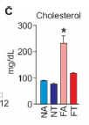
Reduced Cholesterol
Notes:
The production of bile acids were also found to be upregulated in FT groups, leading to a significant reduction in cholesterol levels as compared with the unrestricted high fat diet group.

Slide 30
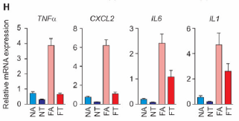
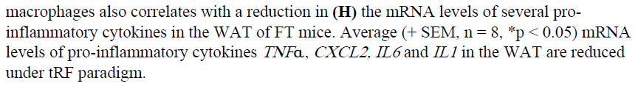
↓Pro-inflammatory Cytokines
Notes:
The mRNA levels of the pro-inflammatory cytokines TNFa, CXCL2, IL6 and IL1, all common in the white adipose tissue of mice, was significantly reduced in time restricted feeded groups, and especially in FT compared to FA.

Slide 31
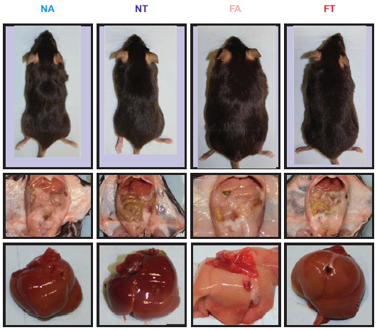
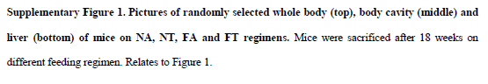
Notes:
So, just lastly for the shock factor, the apparent improved state of the intermittent fasting high fat diet group compared to the high fat diet group with food readily available is evident of the effectiveness of this therapy.

Slide 32
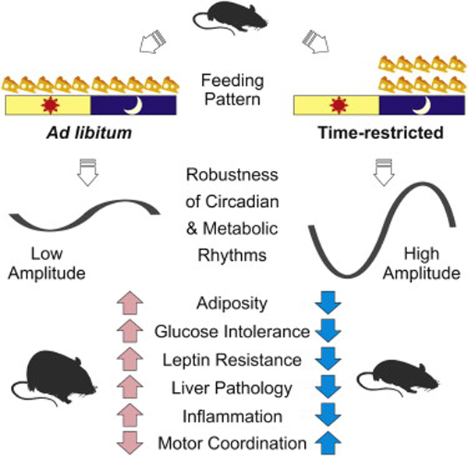
Notes:
Take together, Hatori et al. found that mice who only had temporary access to the exact same amount of food as a group who could eat at free will, showed significant decreases in body fat, had a reduced glucose intolerance, decreased leptin resistance, decrease in liver pathology, less inflammation and an improved motor coordination.
http://www.elitefts.com/education/motivation/nysc-undercover-should-we-avoid-eating-at-night/

Slide 33
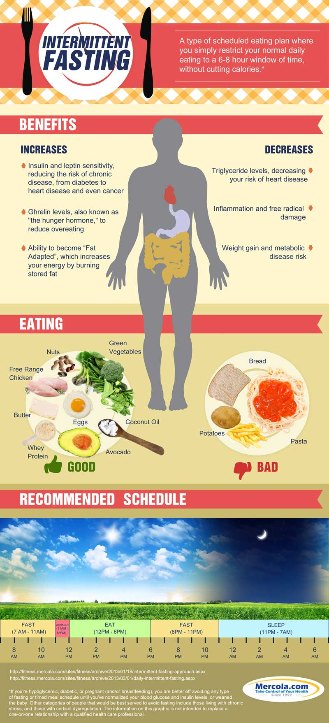
Notes:
So, in conclusion, and also to get a bit practical, restricting your normal daily eating to a 6-8 hour window, without cutting the amount of calories, has the potential to have various benefits, including: increasing your insulin sensitivity and reducing weight gain, thereby reducing your risk for diabetes and cardiovascular diseases. Also, enhanced fat metabolism during fasted state can help reduce blood triglyceride levels also lowering your risk of heart disease. This should still be accompanied with a healthy diet rather than just eating convenient food. Practically, this diet can be implemented by skipping breakfast, having a lunch brunch and eating just after getting home again, whereafter you fast the entire night, sleep and tomorrow we start again.
http://media.mercola.com/assets/images/infographic/intermittent-fasting.jpg

Slide 34
Thank You

Slide 35
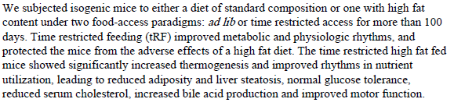
Conclusion

Slide 36
Methods
Animals
Whole body indirect calorimetry was carried out on a subset of mice at 4, 8 or 12 weeks
All other measurements were carried out on a subset of mice at least 12 weeks after the initiation of the feeding regimens.

Slide 37
Diet-induced obesity (DIO) models attributed to increased caloric intake from fat.
Animals fed high fat diet (HFD) ad libitum eat frequently throughout day and night disrupting the normal feeding cycle.
To test whether obesity and metabolic diseases result from HFD or disruption of metabolic cycles:
Mice divided into 2 groups with equal calories:
Ad libitum feeding
Time restricted HFD feeding for 8h/day
Time restricted protected against
Obesity
Hyperinsulinemia
Hepatic steatosis
Inflammation
Improves motor coordination
improved CREB, mTOR and AMPK pathway function
Improved oscillations of the circadian clock and their target genes‘ expression
These changes in catabolic and anabolic pathways altered liver metabolome, improved nutrient utilization and energy expenditure
We demonstrate in mice that tRF regimen is a non-pharmacological strategy against obesity and associated diseases.

Slide 38
Time restricted feeding prevents excessive body weight gain, hepatosteatosis and liver damage
FT mice were also protected from the hepatomegaly and elevated serum alanine aminotransferase (ALT) levels that are associated with obesity-induced hepatic steatosis (Figures 4J and 4K). To further characterize the pathologic state and steatosis of the liver in these four groups, we used a Brunting scoring system under blinded conditions. Tissue samples from the FT mice had significantly less hepatic steatosis compared to those from the FA mice (Figures 5A and 5B). In addition, volume analyses of serial block-face scanning electron microscope images of the liver samples revealed that livers from the FT mice did not have the profound increase in intracellular fat deposits, reduce mitochondrial density and reduced endoplasmic reticulum that were characteristic of the liver samples from the FA mice (Figures 5C, 5D and Table S2).

Slide 39
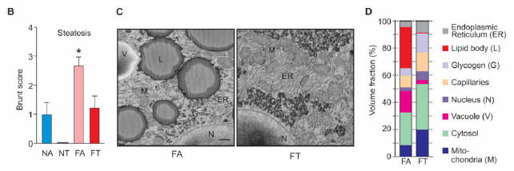
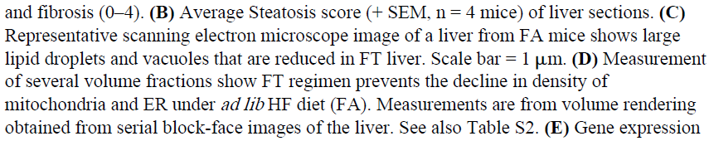

Slide 40
Time restricted feeding improves bile acid production, adipose tissue homeostasis and alleviates inflammation
Elevated β-oxidation and reduced fatty acid synthesis in the liver coupled with increased BAT energy expenditure observed in the FT mice prevented the adipocyte hypertrophy common to BAT and white adipose tissue (WAT) derived from the FA mice (Figures 6F and 6G).
Furthermore, inflammation marked by extensive infiltration of macrophages and expression of proinflammatory genes, including TNFα, IL6 and CXCL2 that are generally found in the WAT of the FA mice, were attenuated in the FT mice (Figure 6H). Even in mice fed normal diet, tRF reduced the expression of inflammatory cytokines in the WAT. In summary, the tRF paradigm affected multiple tissues and improved whole body energy homeostasis, and reduced inflammation.

Slide 41
